Slide 1

Appium Architecture

Slide 2
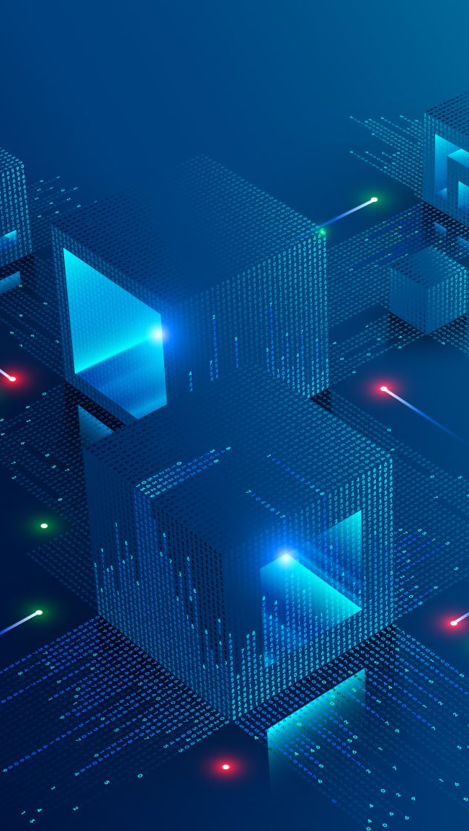
Three components of Appium architecture,
Appium Client
Appium Server
End device
It follows Client Server Architecture

Slide 3
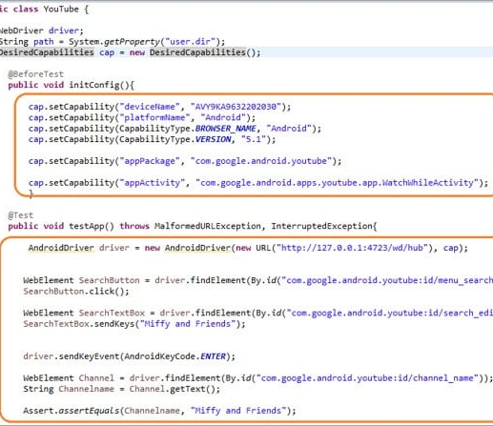
Appium Client
The automation scripted code is what we call as Appium Client.

Slide 4

Appium Server
Appium server is written using Node.js programming language.
It receives connection and command requests from the Appium client in JSON format and executes that command on mobile devices.
The Server is necessary to be installed in the machine and is started before invoking the automation code.
To start the server, users need to download the source or install it directly from Npm.

Slide 5
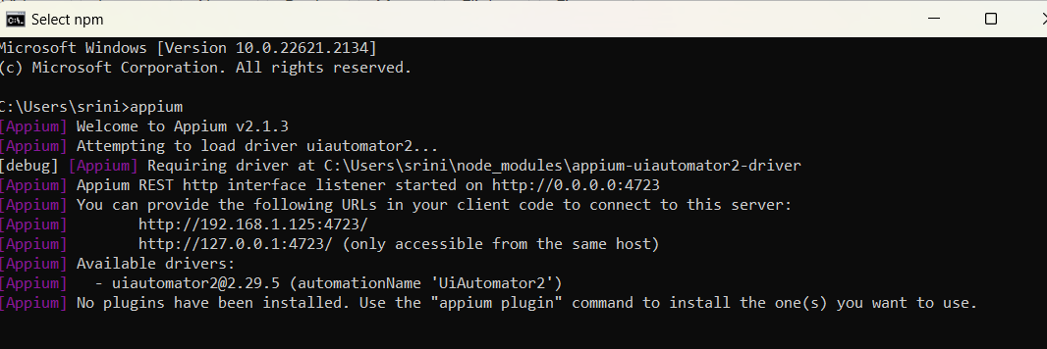
Start - Appium server – windows

Slide 6
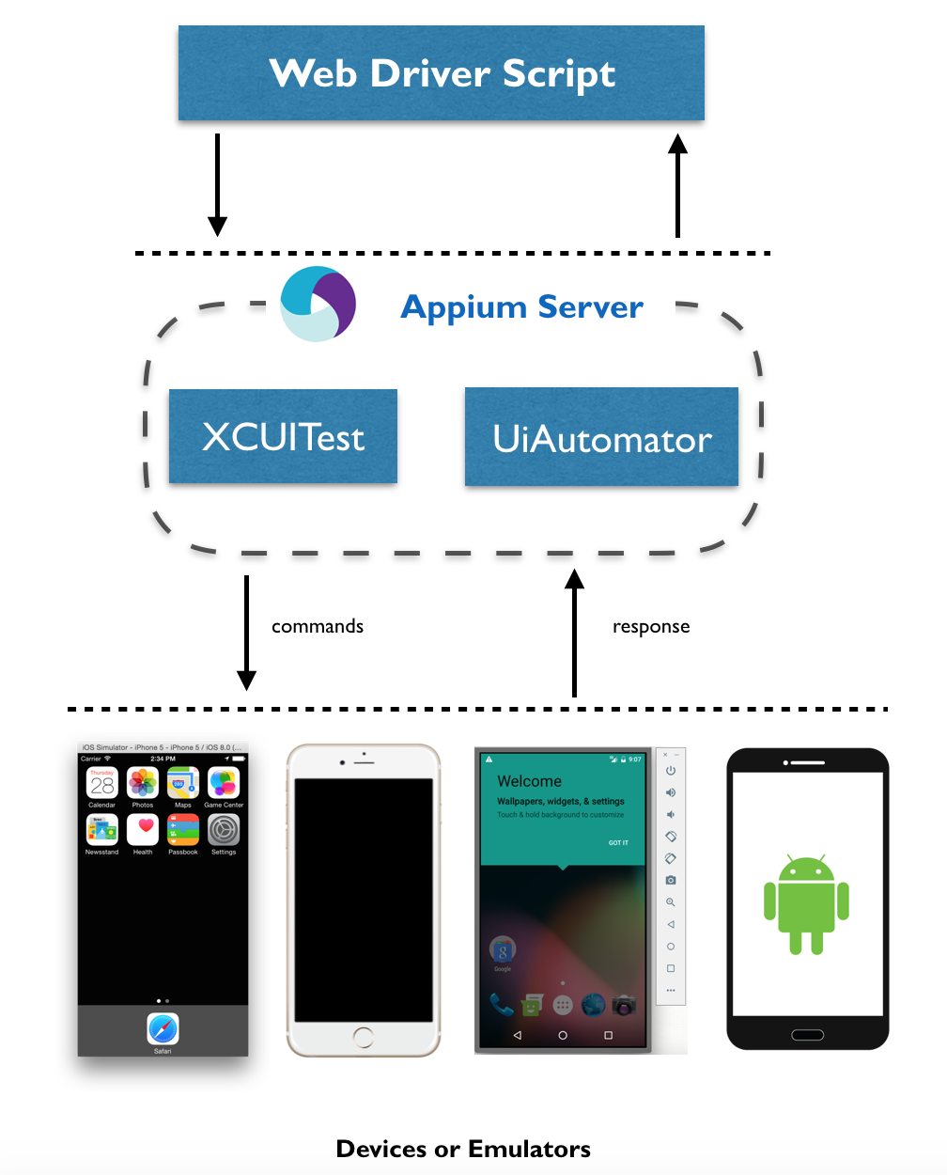
End Device

Slide 7
UIAutomator
Appium uses the UIAutomator framework to interact with the UI elements of the application on an Android device. The UIAutomator is a framework that is developed by the Android developers to test its user interface

